Slide 1
Fine-Tuning LLMs for Croatian Text Retrieval
Goran Ivanković
Marko Horvat, University of Zagreb, Faculty of Electrical Engineering and Computing
Marko Horvat, University of Zagreb, Faculty of Science, Department of Mathematics

Slide 2



Overview
What are Large Language Models (LLMs)?
Text retrieval with vector embeddings
Investigate the use of LLMs for text retrieval through embeddings
Enhance datasets for the retrieval of Croatian text and benchmark open-source models on them
We fine tune several LLMs and other models on our custom dataset

Slide 3
Large language model
Predicts the probability of the next word in a sequence
Contains billions of parameters
John
is
books
magazines
…
potatoes
words
trucks
0.76
0.13
0.08
0
0
reading

Slide 4
Embedding model
Transforms text into a high-dimensional vector representation (e.g., 3584 dimensions)
Enables similarity search between texts using cosine similarity
Bite sized pistachio and walnut
rolled baklava - Burma Baklawa
How Turkey Makes
MOIST & TENDER Kebabs
Query:
How to make that famous
Turkish desert?
Russian fighter jets intercepted
in Estonian airspace
Canada, Mexico eye stronger
ties amid Trump tariff threat

Slide 5

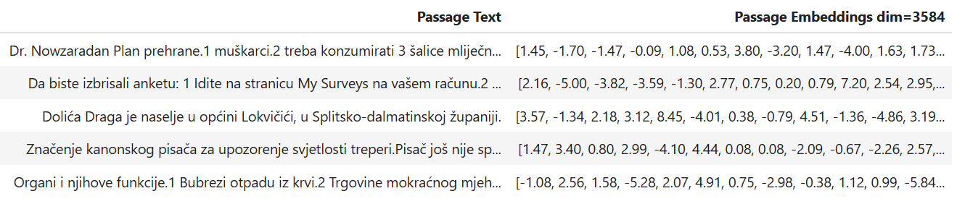
Embedding model
Example of how a query and passages may be stored in the vector embeddings format

Slide 6
Transformer architecture
[John], [reads], [books], [inside], [the]
Word embedding
Initial word
embeddings
Converts words into initial word embeddings
Embeddings pass through a sequence of decoder blocks
Final embeddings are used to predict next-word probabilities
Decoder block
x N
Last layer
embeddings
Transformer head
Next word
probabilities

Slide 7

Transformer architecture
[John], [reads], [books], [inside], [the]
Word embedding
Initial word
embeddings
Converts words into initial word embeddings
Embeddings pass through a sequence of decoder blocks
Final embeddings are used to predict next-word probabilities
Decoder block
x N
Last layer
embeddings
Transformer head
[library] 60%
[house] 32%
…
[potatoes] 0%
[forest] 0%

Slide 8
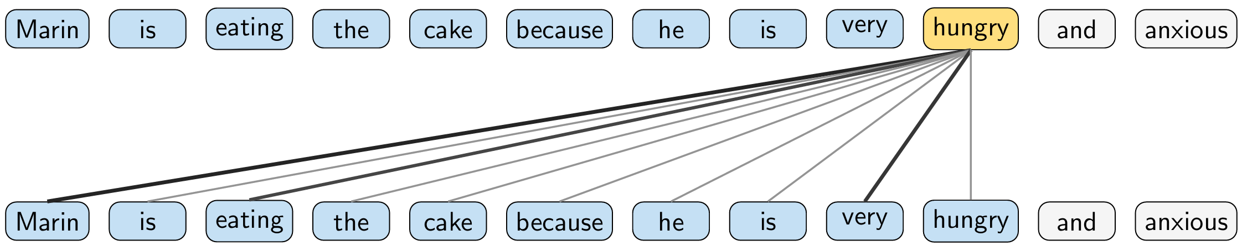
Attention
Key component of a decoder block
Incorporates other word embeddings through self-attention
Decoder block
x N

Slide 9
The goal
[John], [reads], [books], [inside], [the]
Word embedding
Initial word
embeddings
Adapt an LLM to function as an embedding model
Decoder block
x N
Last layer
embeddings
Transformer head
Next word
probabilities

Slide 10
The goal
[John], [reads], [books], [inside], [the]
Word embedding
Initial word
embeddings
Adapt an LLM to function as an embedding model
Methods:
Average vector
Decoder block
x N
Last layer
embeddings
Average vector
Whole text
embedding

Slide 11
The goal
[John], [reads], [books], [inside], [the]
Word embedding
Initial word
embeddings
Adapt an LLM to function as an embedding model
Methods:
Average vector
Last vector
Decoder block
x N
Last layer
embeddings
Last vector
Whole text
embedding

Slide 12
Fine-tuning models for text retrieval
Train models on query–passage pairs
Optimize model parameters to minimize the distance between a query and its correct passage, while maximizing the distance to other passages
Bite sized pistachio and walnut
rolled baklava - Burma Baklawa
How Turkey Makes
MOIST & TENDER Kebabs
Query:
How to make that famous
Turkish desert?
Russian fighter jets intercepted
in Estonian airspace
Canada, Mexico eye stronger
ties amid Trump tariff threat

Slide 13
Datasets
MSMarcoWiki-HR
Training dataset
MQA-HR
Test dataset

Slide 14
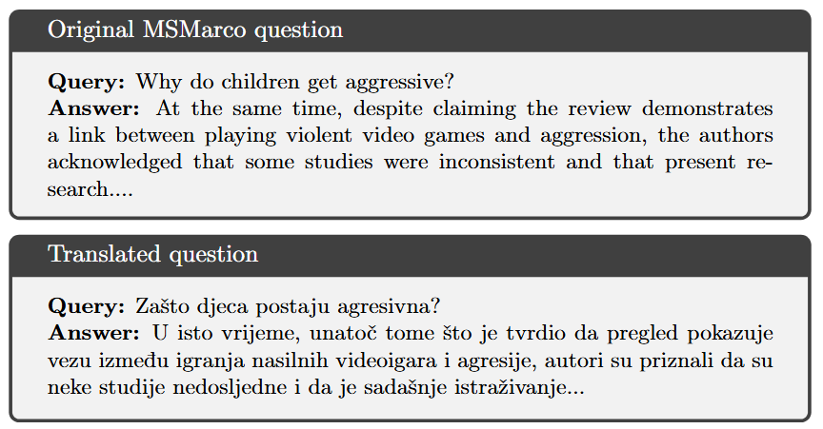
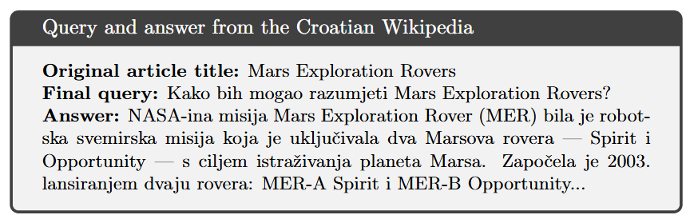
MSMarcoWiki-HR
19,814 query-passage pairs
Compiled from two sources
MSMarco (translated into Croatian)
Croatian Wikipedia – title + first passage
Used for fine-tuning the models

Slide 15
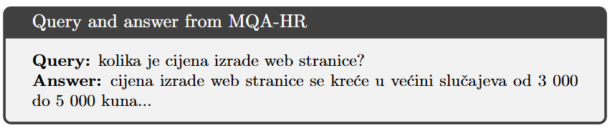
MQA-HR
1,100 query-passage pairs
Filtered from MQA dataset — real Croatian questions from the Internet
Used for model evaluation

Slide 16
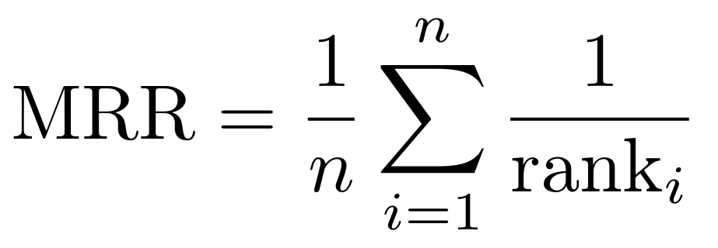
Evaluation metric
Measures how high the correct answer ranks in a list of retrieved passages
rank_{i} = position of the correct passage for the i-th query

Slide 17
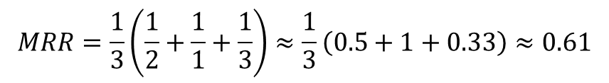
Evaluation metric
Query 1: What is the capital of Croatia? | Query 2: When did Croatia join the EU? | Query 3: Which Croatian city is a UNESCO site?
The Adriatic Sea lies along the Croatian coast. | Croatia joined the European Union in 2013. | The Croatian currency was the kuna until 2023.
Zagreb is the capital of Croatia. | The Croatian currency was the kuna until 2023. | The Adriatic Sea lies along the Croatian coast.
Croatia joined the European Union in 2013. | Zagreb is the capital of Croatia. | Dubrovnik is a UNESCO World Heritage Site.
The Croatian currency was the kuna until 2023. | The Adriatic Sea lies along the Croatian coast. | Zagreb is the capital of Croatia.
Dubrovnik is a UNESCO World Heritage Site. | Dubrovnik is a UNESCO World Heritage Site. | Croatia joined the European Union in 2013.
$$MRR=\frac{1}{3}\left(\frac{1}{2}+\frac{1}{1}+\frac{1}{3}\right)≈\frac{1}{3}\left(0.5+1+0.33\right)≈0.61$$

Slide 18
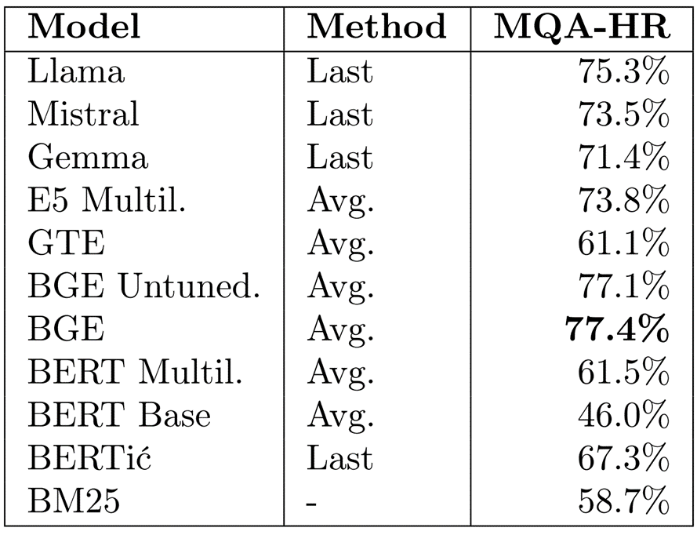
Findings

Slide 19


Conclusion
Successfully adapted LLMs to Croatian text retrieval using embeddings
Created two new datasets for text retrieval in Croatian
Possible usages:
Train custom text retrieval models
Improved search for user manuals and databases

Slide 20
Thank you for your attention!

